Slide 1
Crystal Staffing Solutions
N H By Pass ,Puthiya Road,
Cochin
0484 6463040
www.csssecurity.in

Slide 2
WELCOME
CSS PROVIDED FIRE FIGHT TRANING TO ALL THE MGF / KAIRALI FORD AND VOLVO SITES.

Slide 3
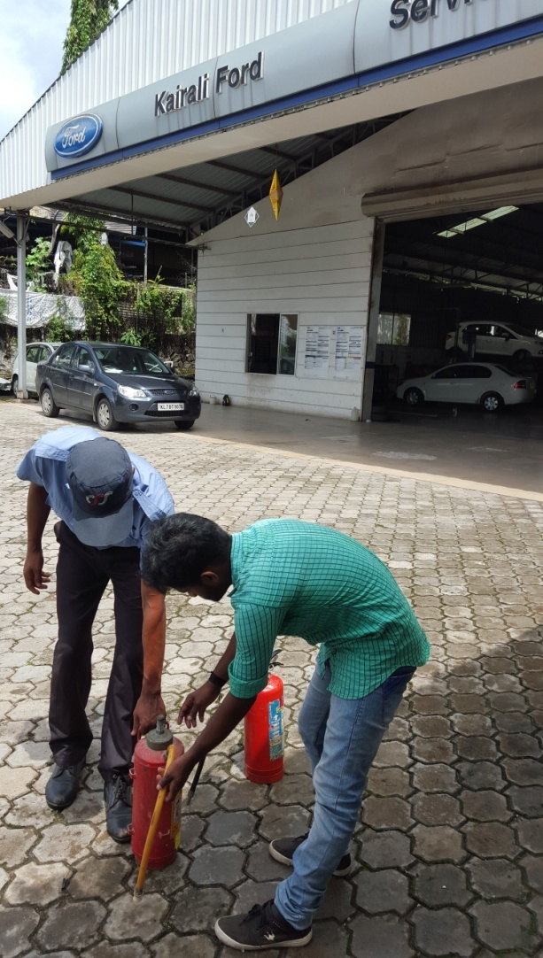
Fire Fight Training Section at different sites

Slide 4
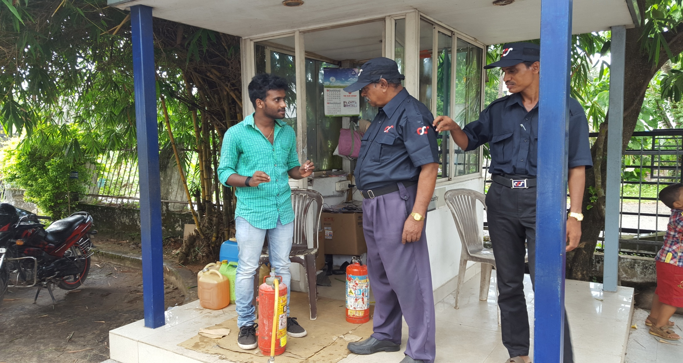
Fire Fight Training Section at different sites

Slide 5
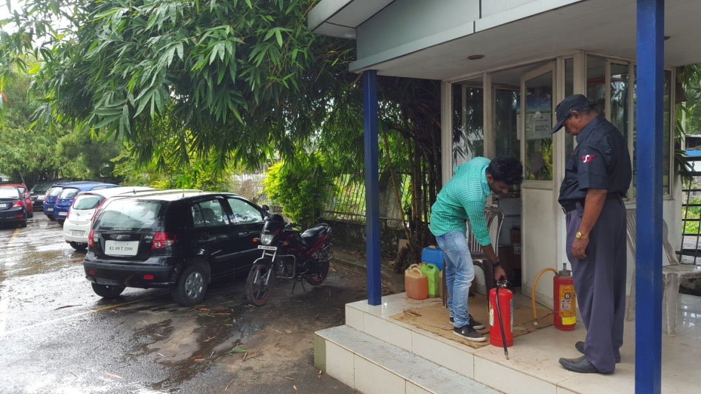

Slide 6
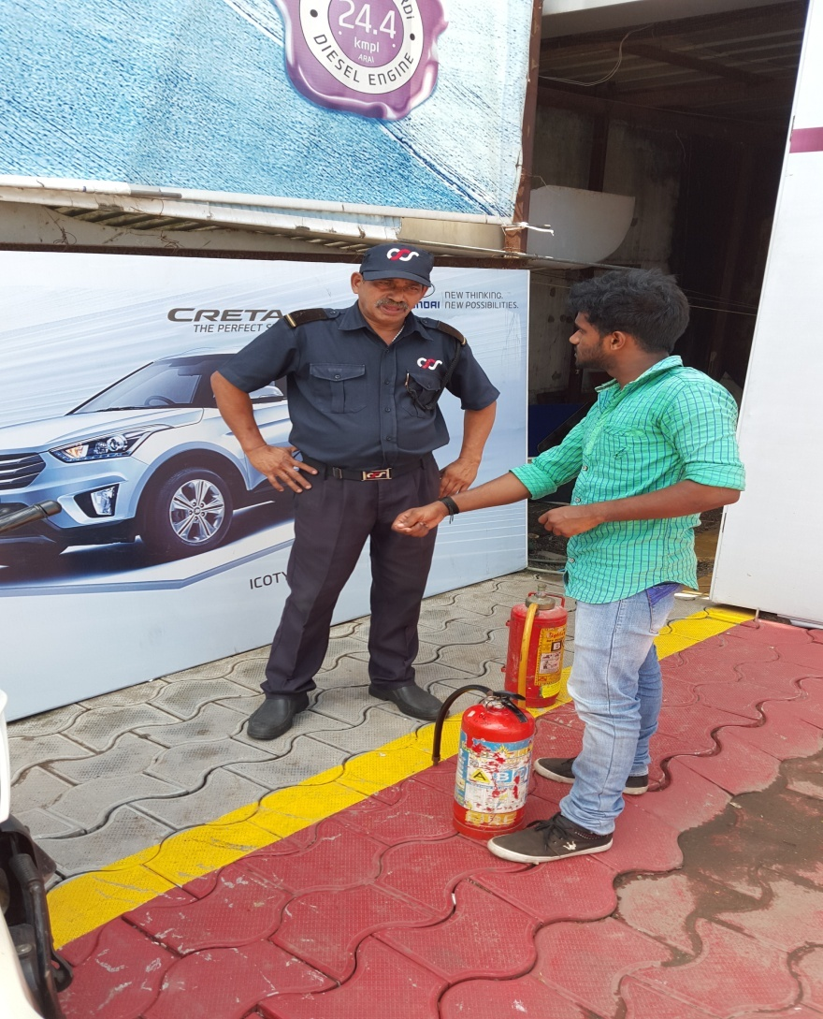

Slide 7
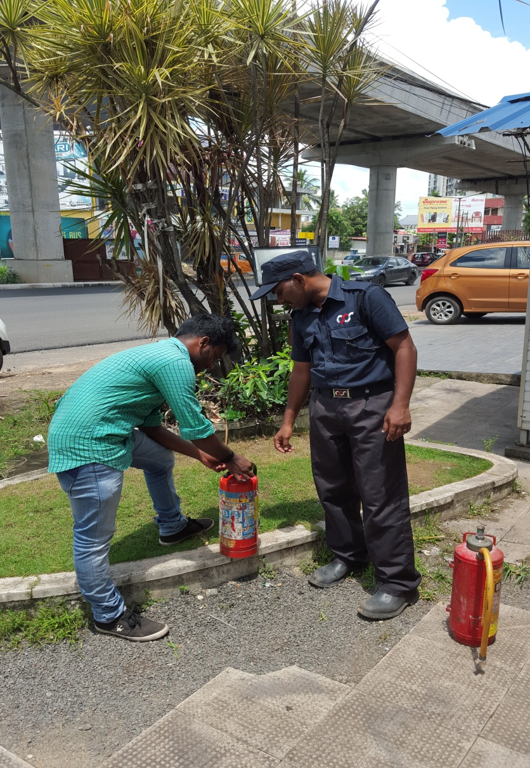
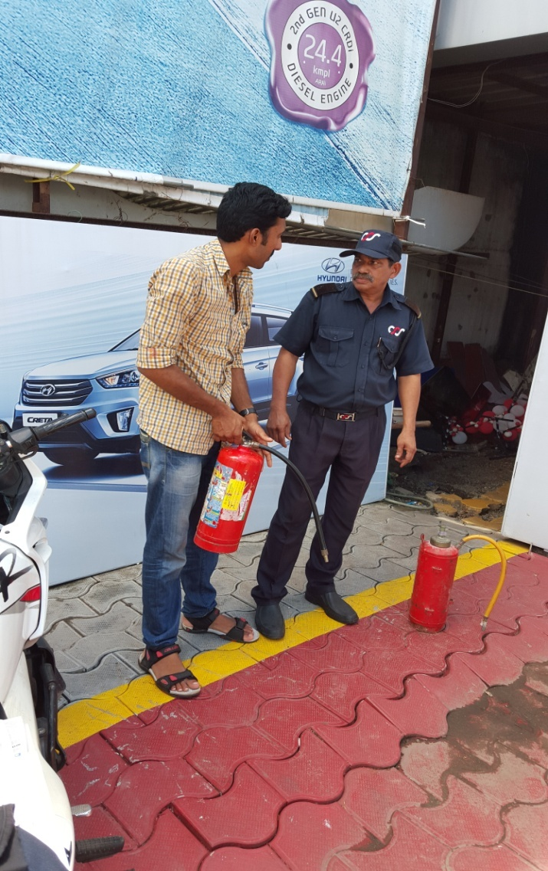

Slide 8
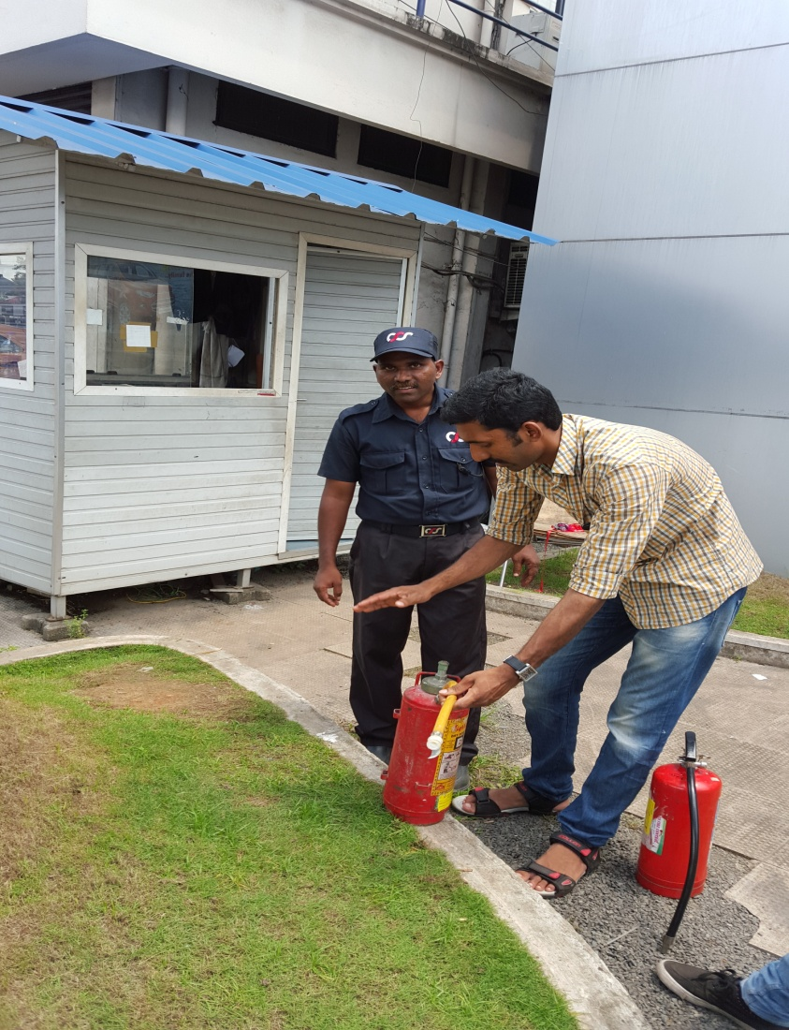
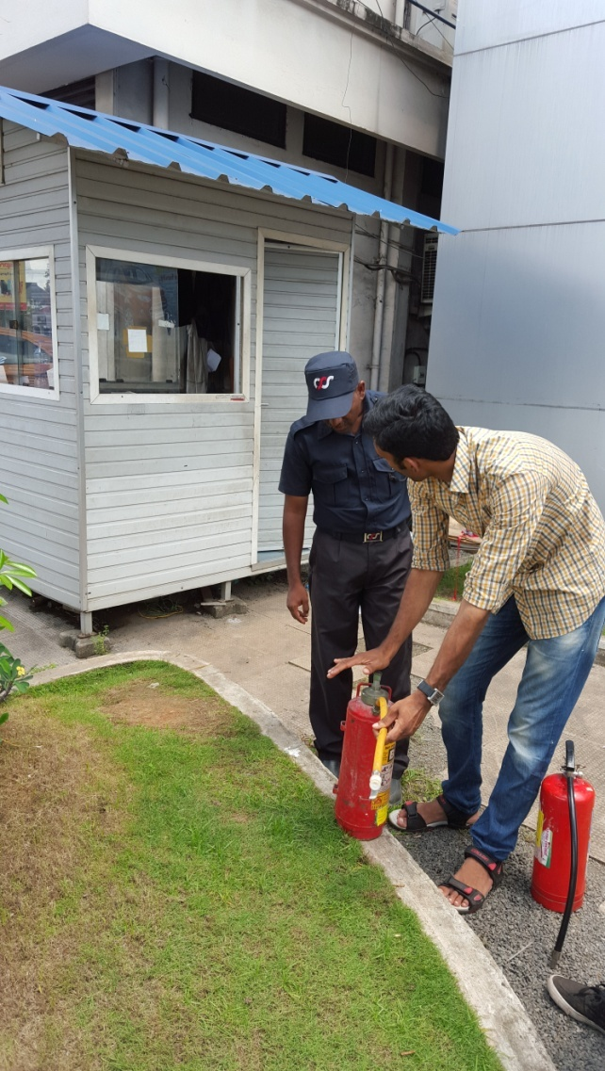

Slide 9
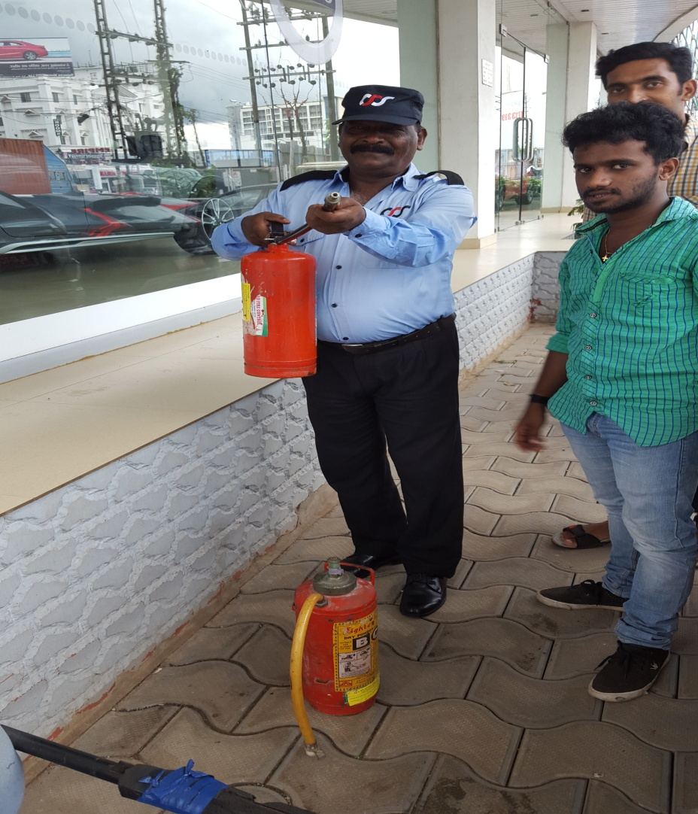

Slide 10
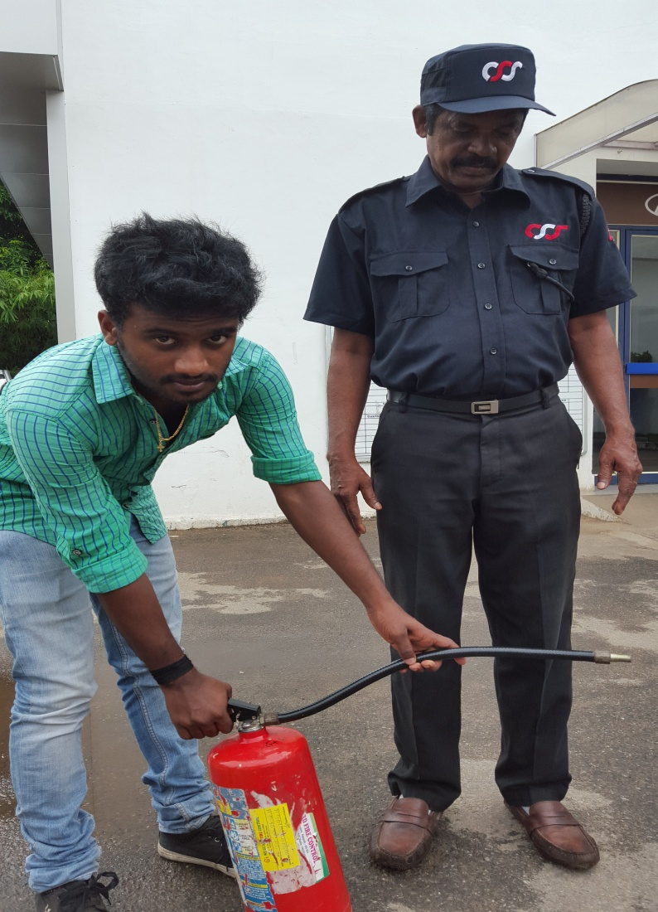
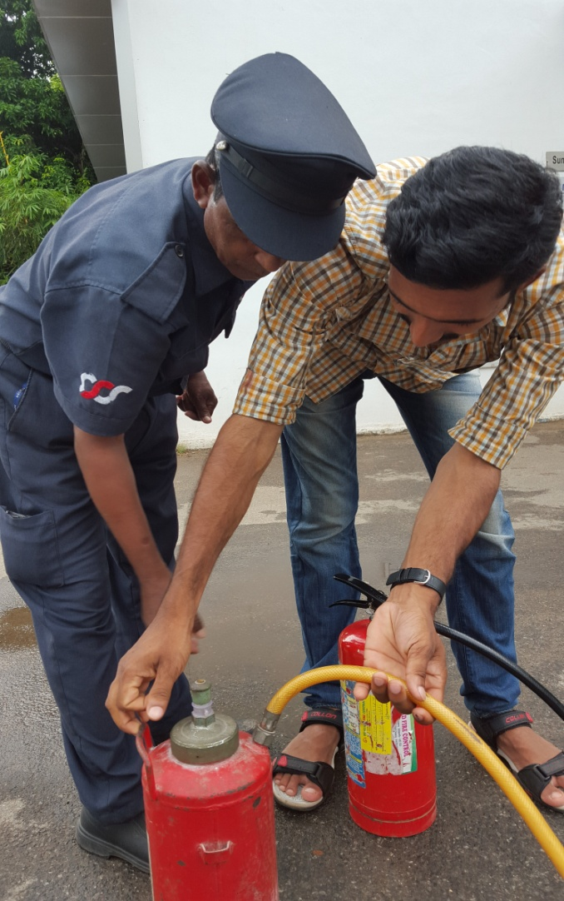

Slide 11
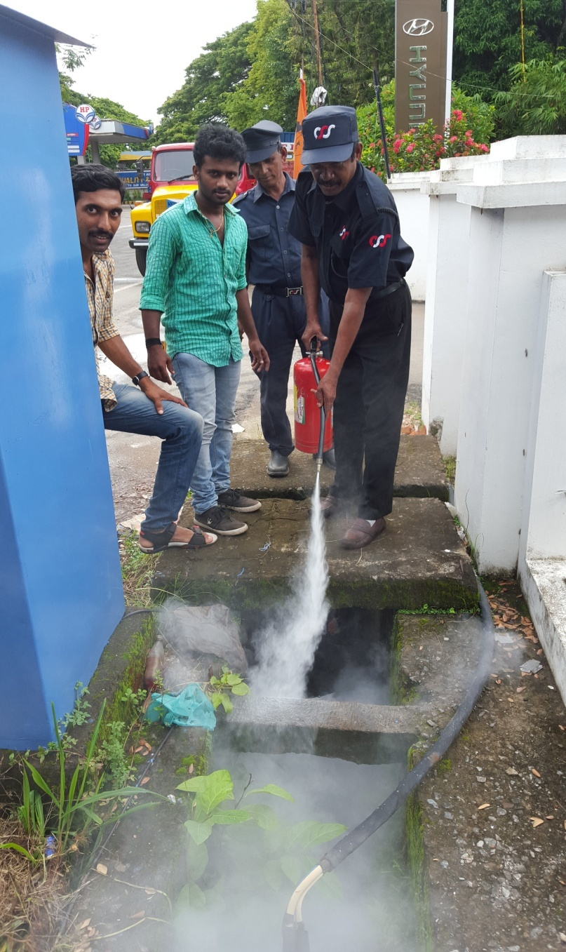
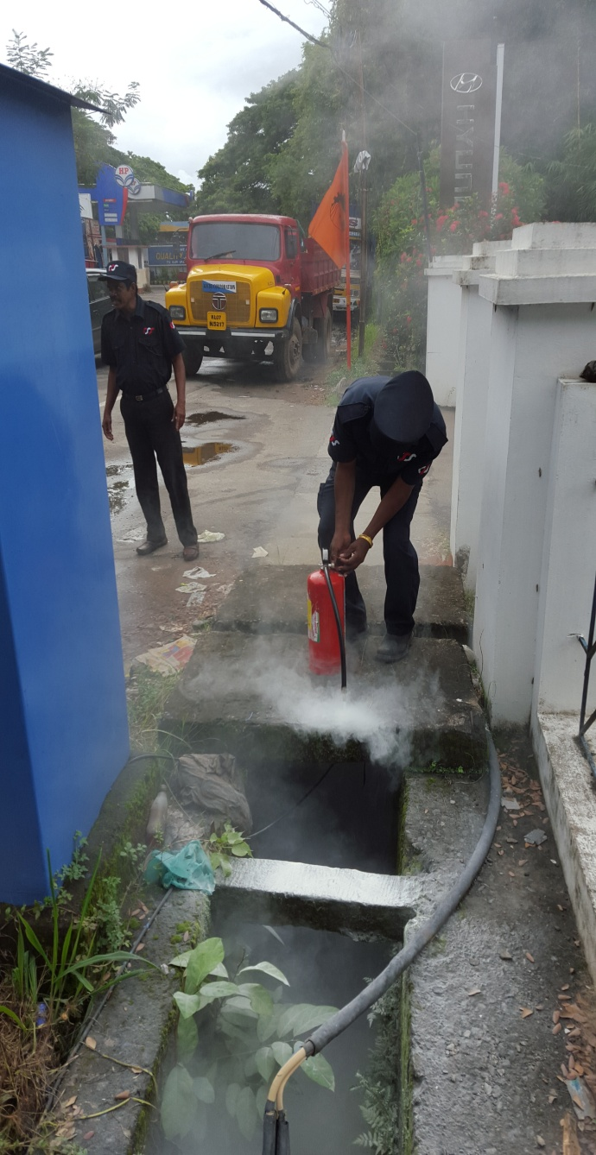

Slide 12
THE END
THANKING YOU

